Slide 1



Slide 2


www.themediaant.com

Slide 3


www.themediaant.com

Slide 4
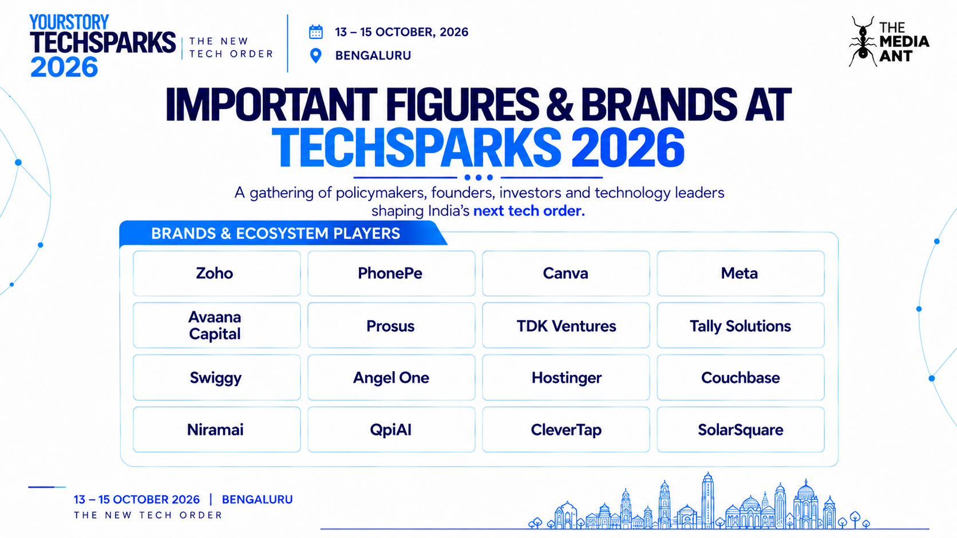
TAJ YESHWANTPUR

Slide 5
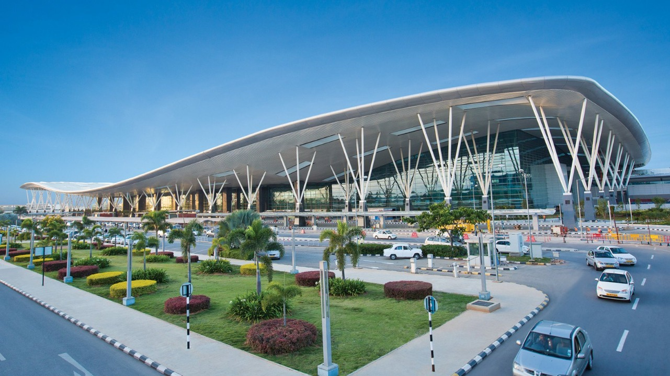


Slide 6
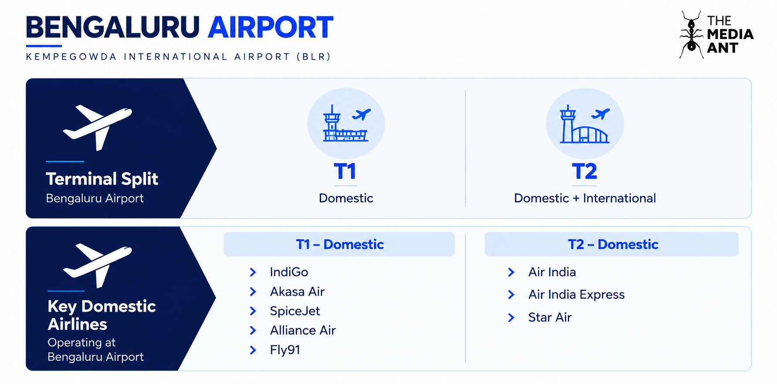

Slide 7
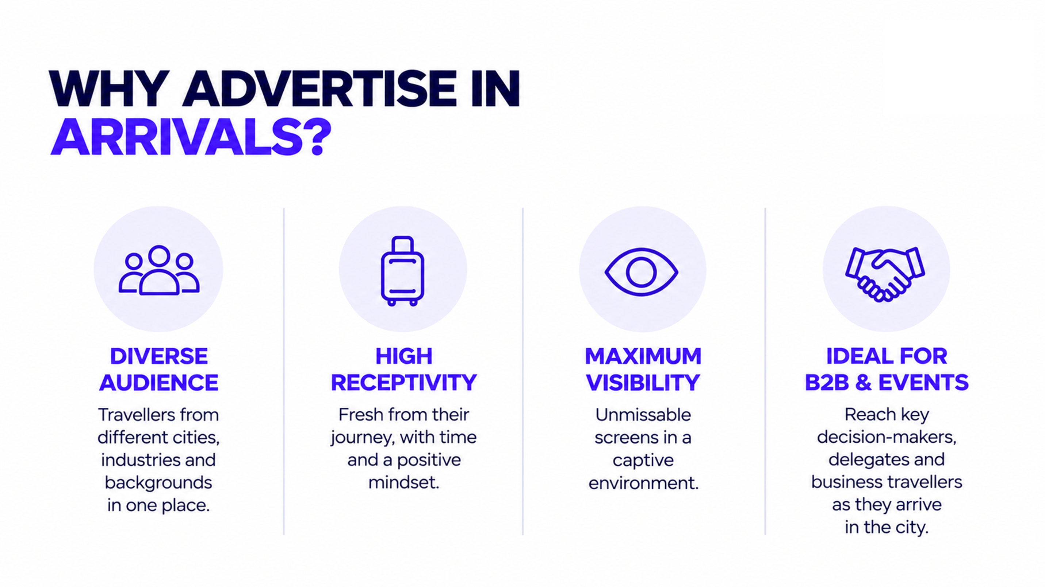

Slide 8




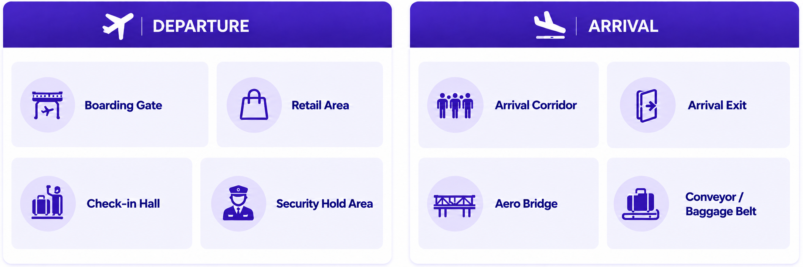
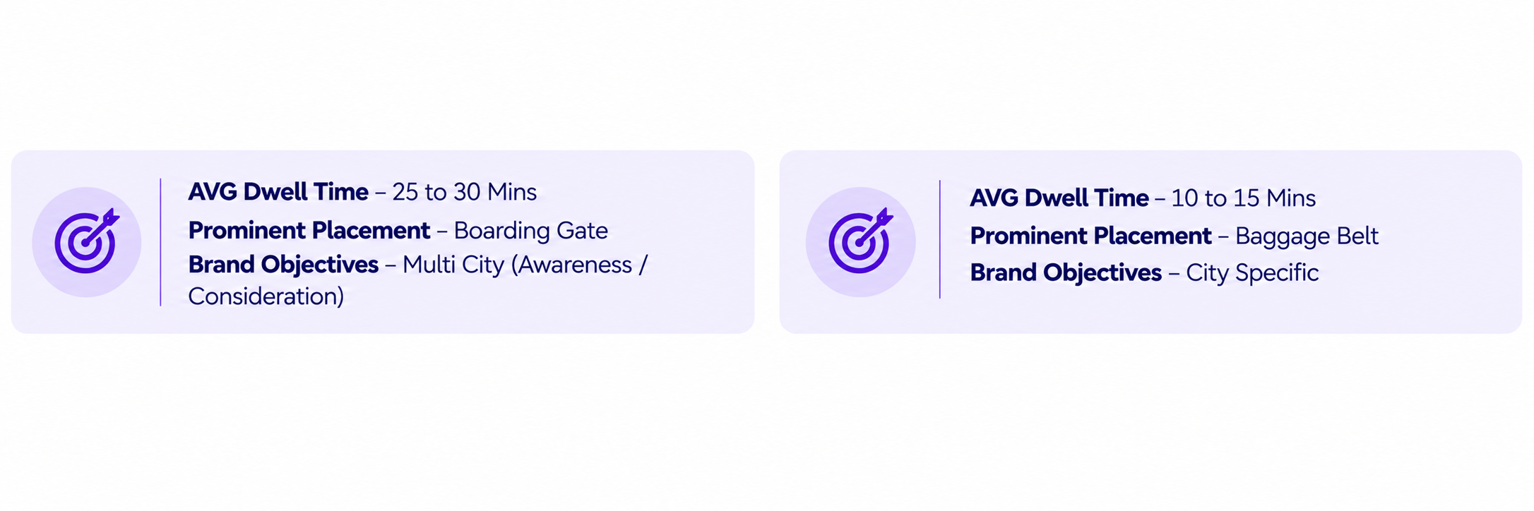
Avg. Dwell time – 5 to 10 mins
Avg. Dwell time – 5 to 10 mins
Avg. Dwell time – 10 to 15 mins
*Green Colour Denotes selection
www.themediaant.com

Slide 9

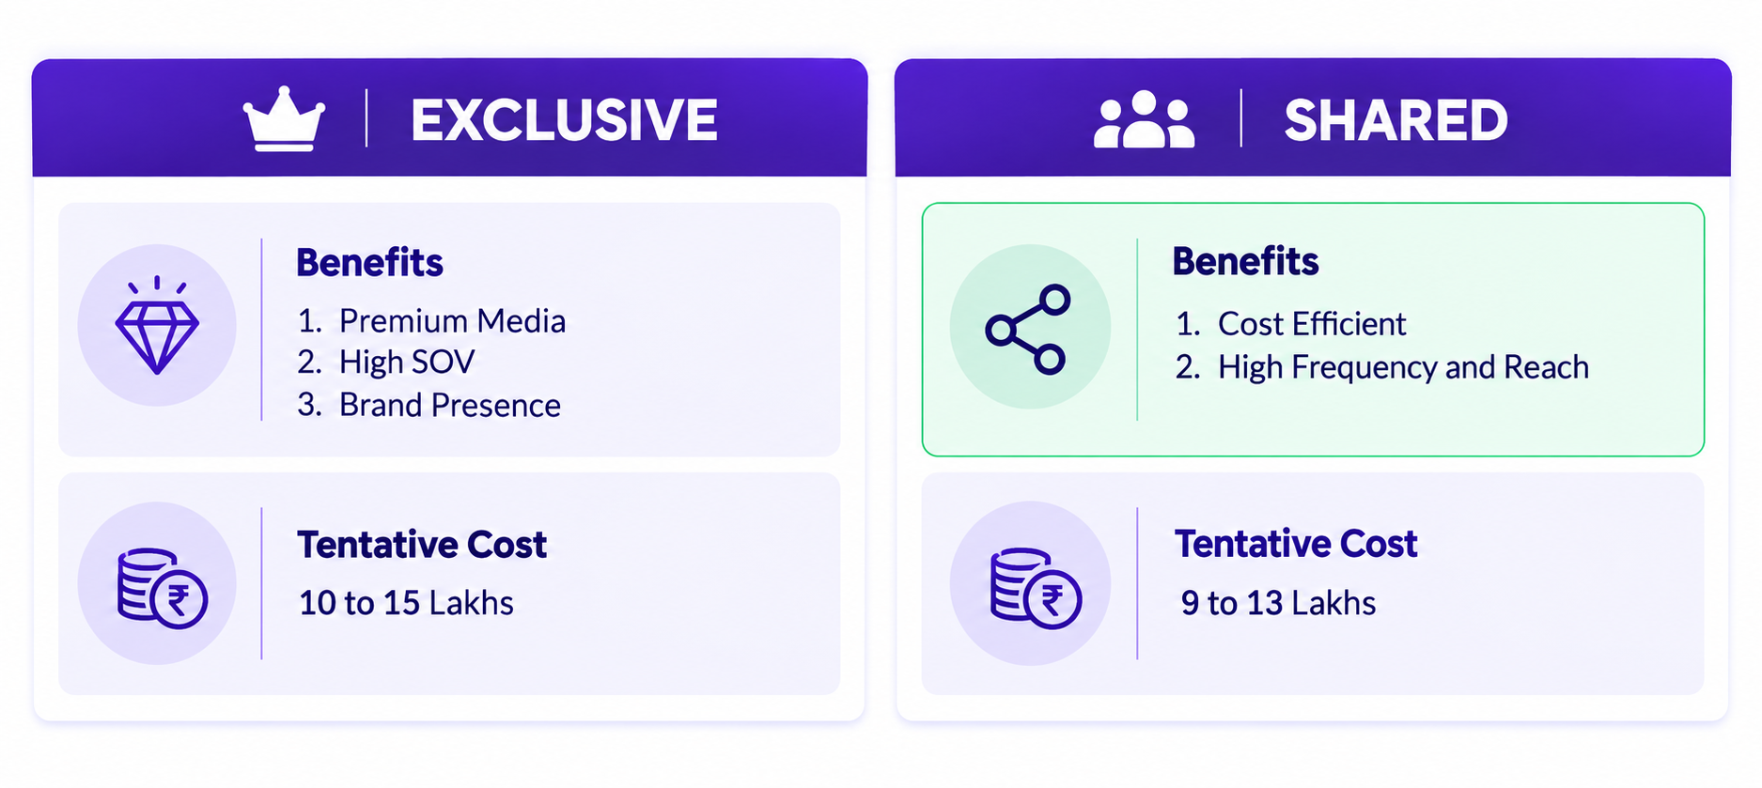
15 to 20 lakhs
10 to 15 lakhs
*Green Colour Denotes selection
www.themediaant.com

Slide 10
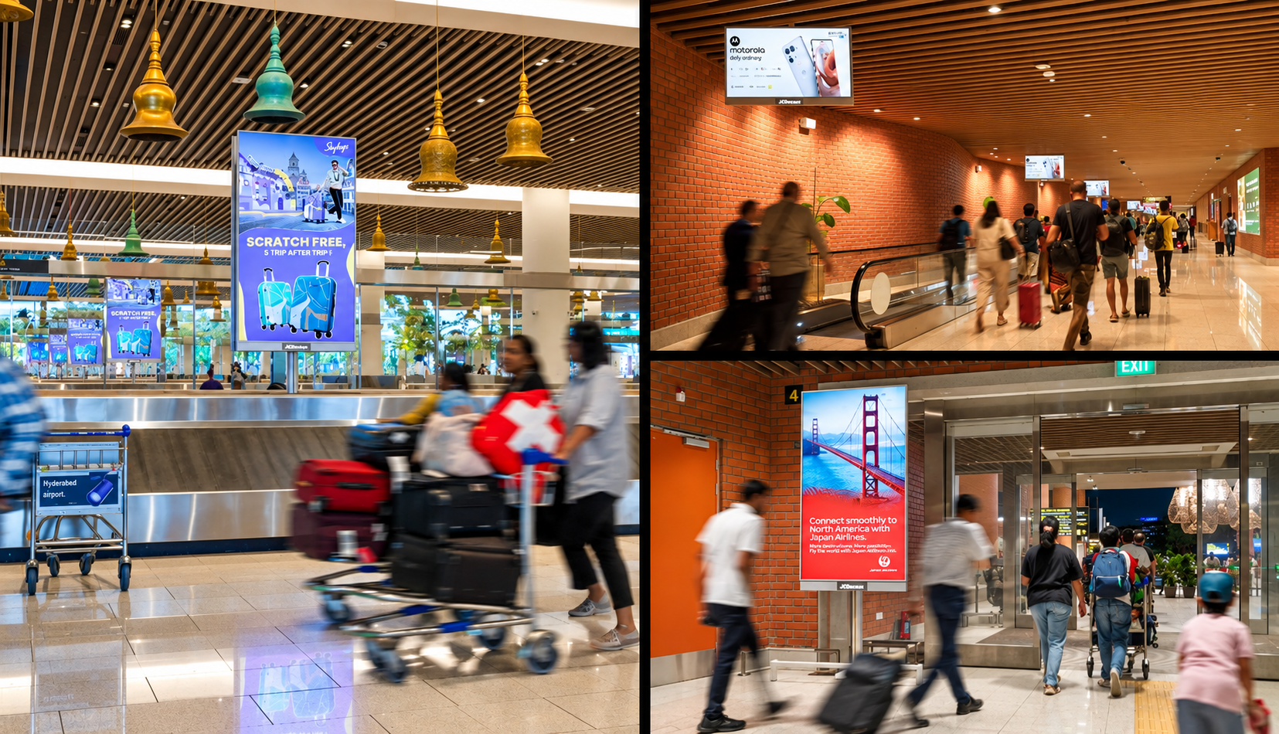
Cost For 7 Days 11,20,000
+ 14,160 Uploading + GST
Cost for 15 Days 20,00,000
+ 14,160 Uploading + GST
Cost Per Month 42,00,000
+ 14,160 Uploading + GST
T2 Domestic Arrivals, Multiple Touch Points (Baggage Belt & Complete arrival flow) Unit – 22, Size – 55 Inches, 85 Inches & 100 Inches, Digital Screen Network, Loop – 10 Secs Slot in 1 min Loop
www.themediaant.com

Slide 11


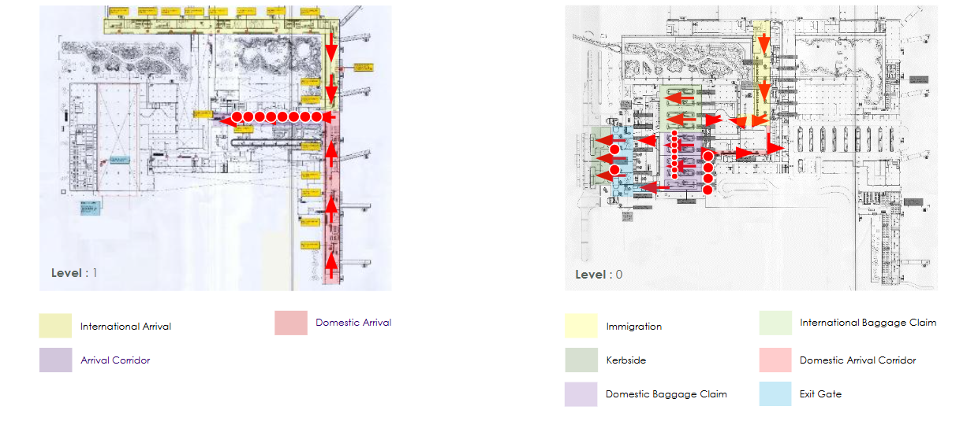
www.themediaant.com

Slide 12
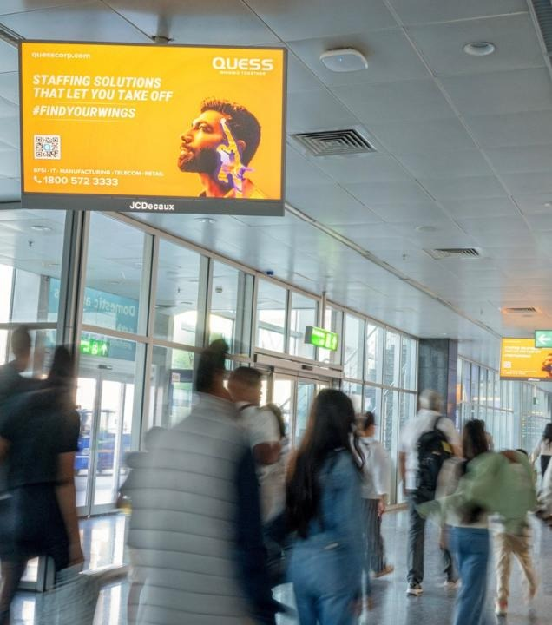
Cost For 7 Days 4,67,000
+ 14,160 Uploading + GST
Cost for 15 Days 8,00,000
+ 14,160 Uploading + GST
Cost Per Month 17,00,000
+ 14,160 Uploading + GST
T1 Domestic Arrival Corridors, Unit – 12, Size – 55 Inches, Digital Screen, Loop – 10 Secs Slot in 1 min Loop
www.themediaant.com

Slide 13
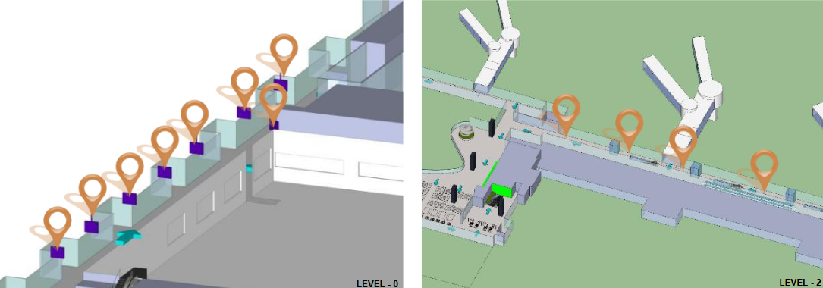
www.themediaant.com

Slide 14
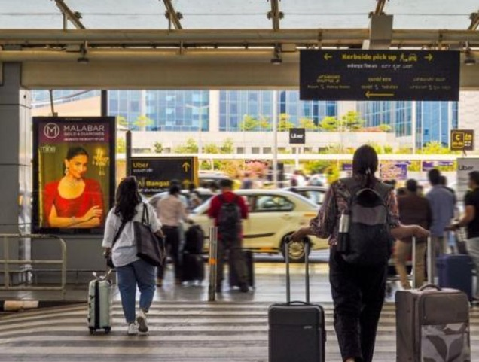
Cost For 7 Days 4,20,000
+ 14,160 Uploading + GST
Cost for 15 Days 7,00,000
+ 14,160 Uploading + GST
Cost Per Month 16,00,000
+ 14,160 Uploading + GST
T1 Common Terminal Exterior, Unit – 8, Size – 4 (W) x 6 (H) ft, Backlit Scroller Mupi, Loop- 10 secs per 40 secs
*Subject to Availability
www.themediaant.com

Slide 15
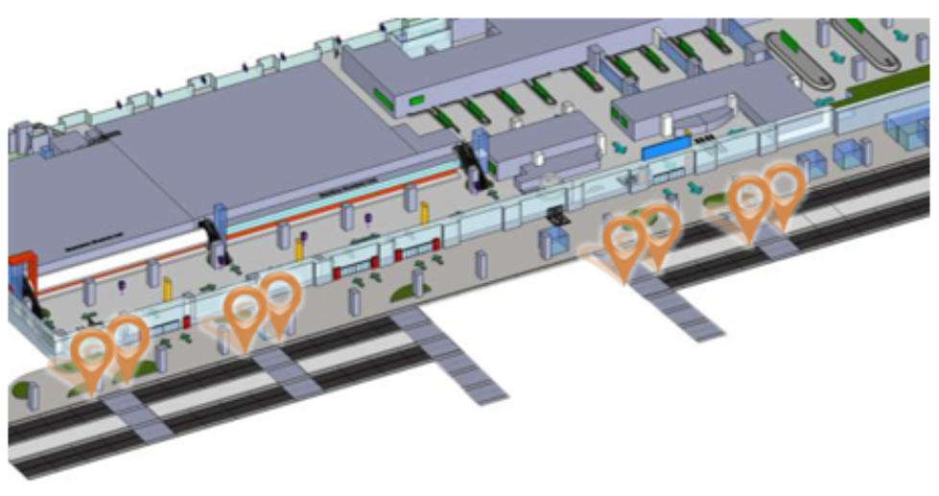
www.themediaant.com

Slide 16

View More

Slide 17

Notes:
35

