Slide 1

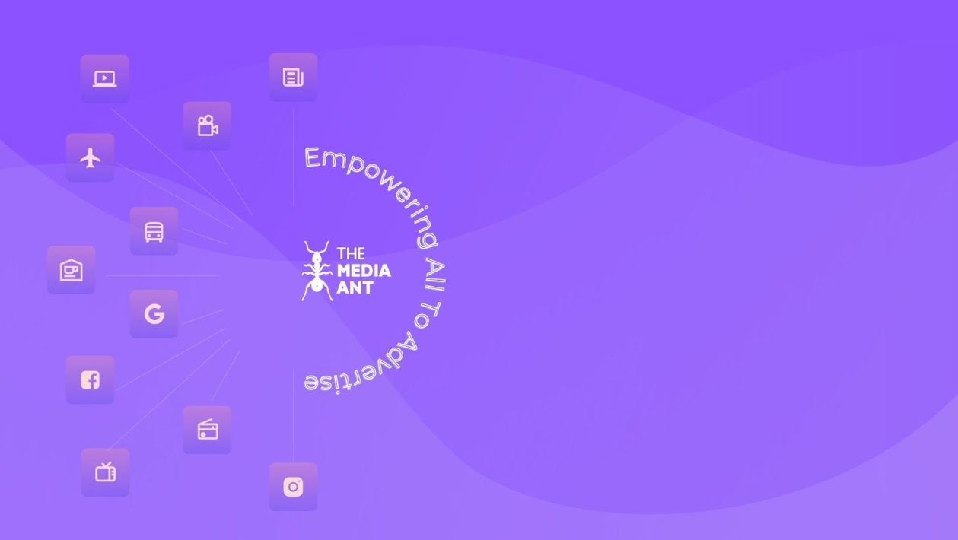

Slide 2
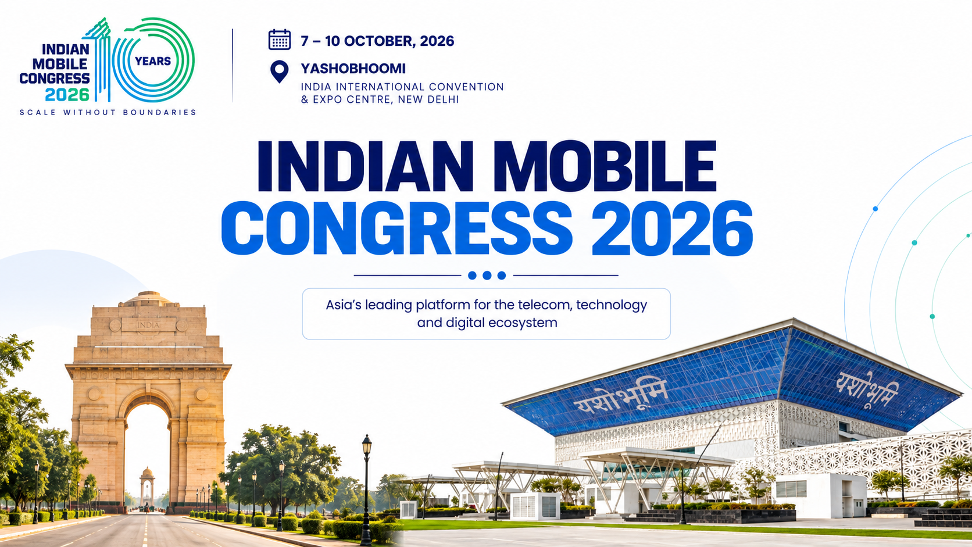


Slide 3
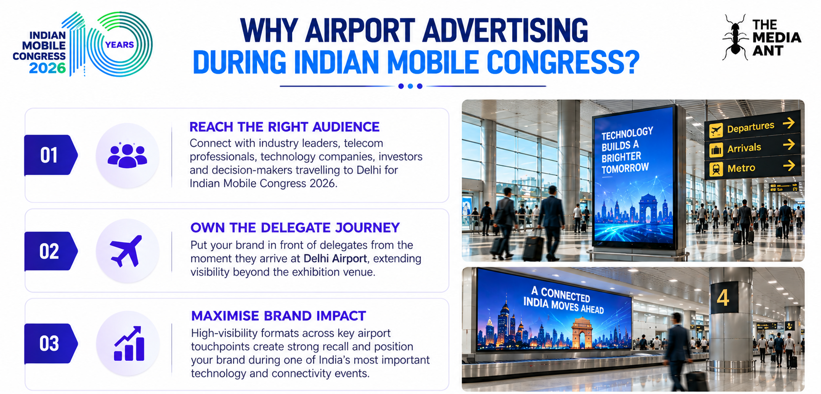
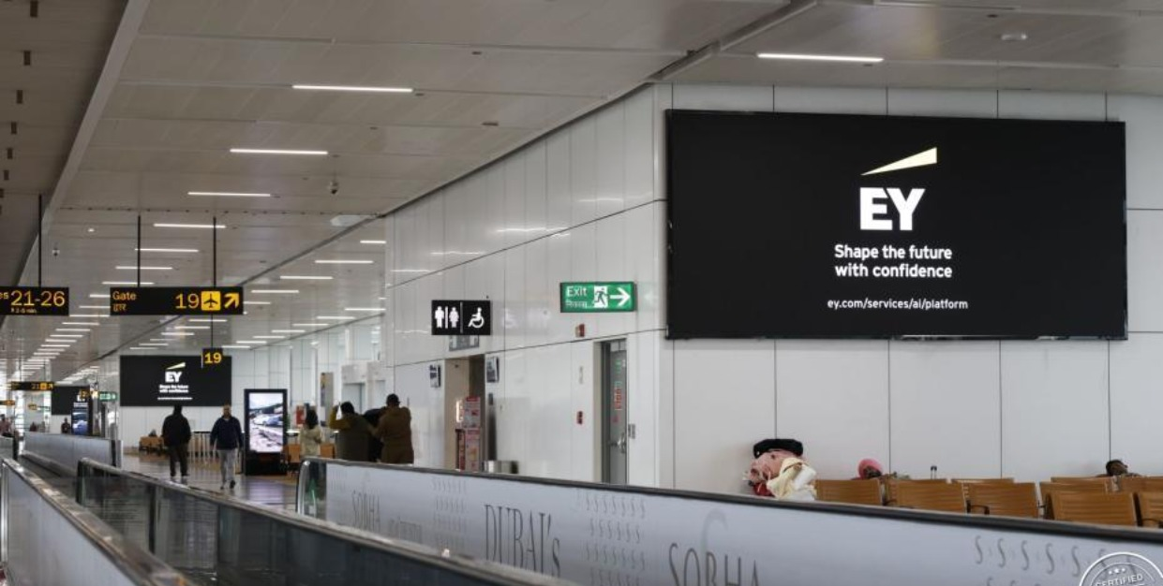
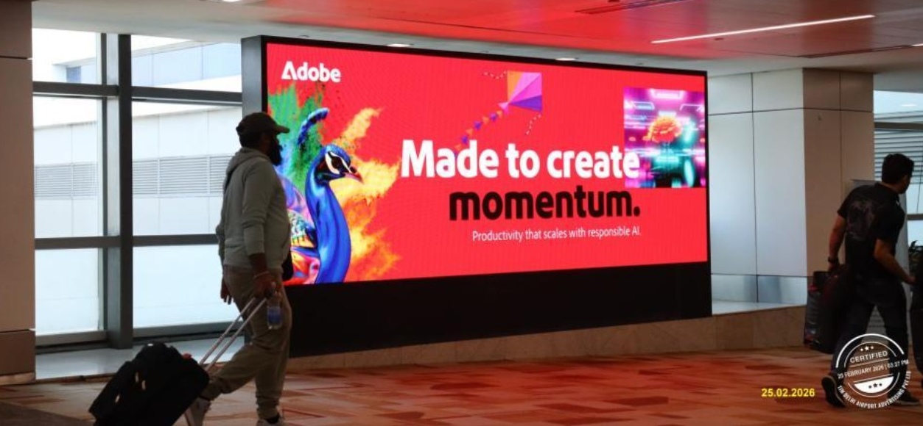
www.themediaant.com

Slide 4


Slide 5
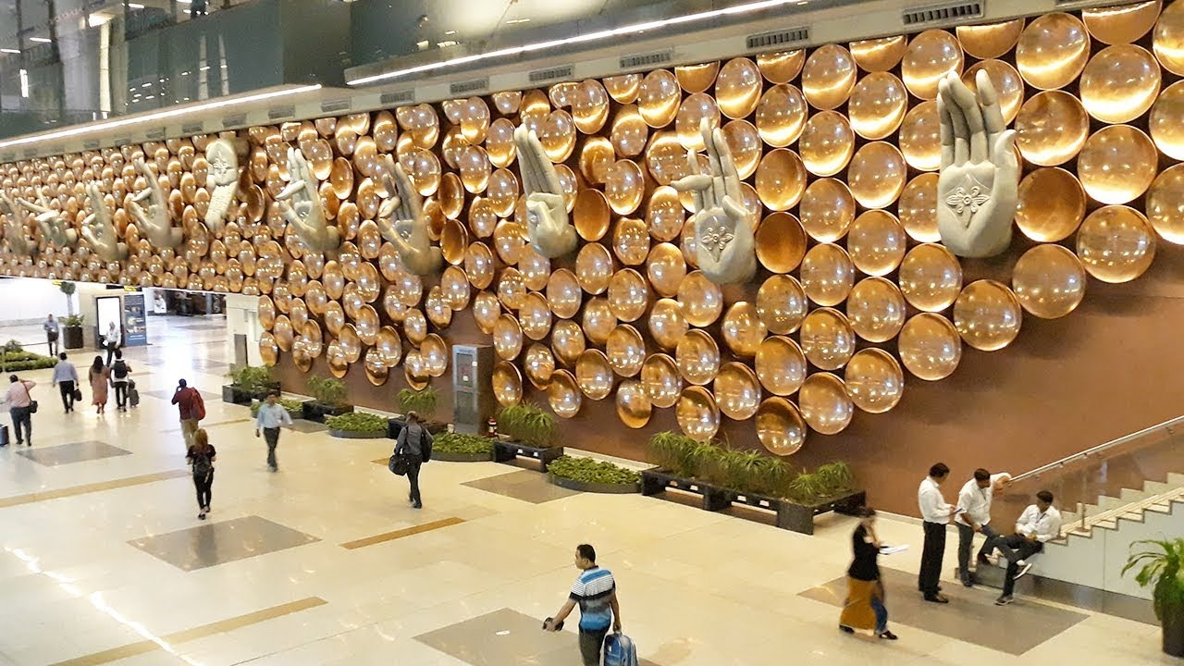


Slide 6
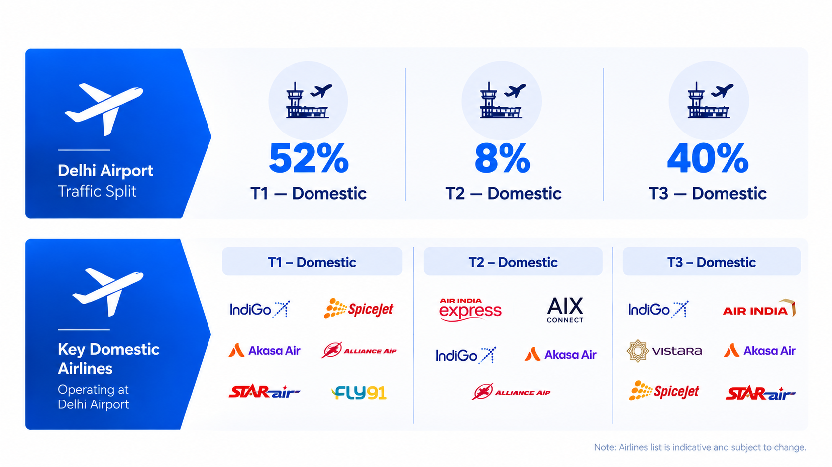
www.themediaant.com

Slide 7
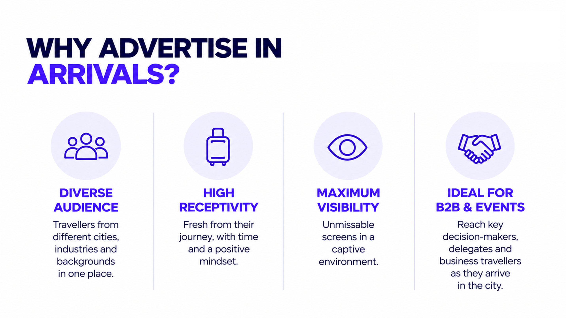

Slide 8




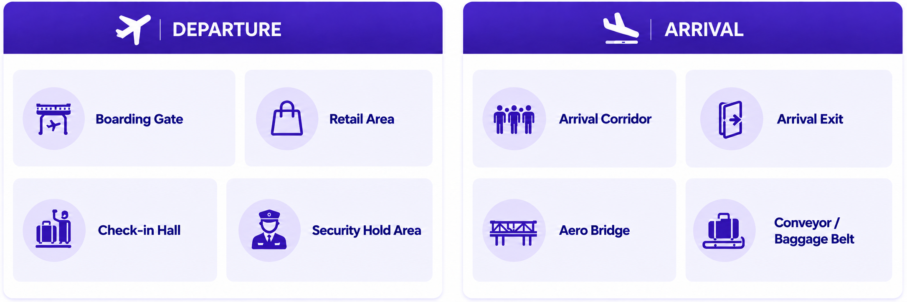
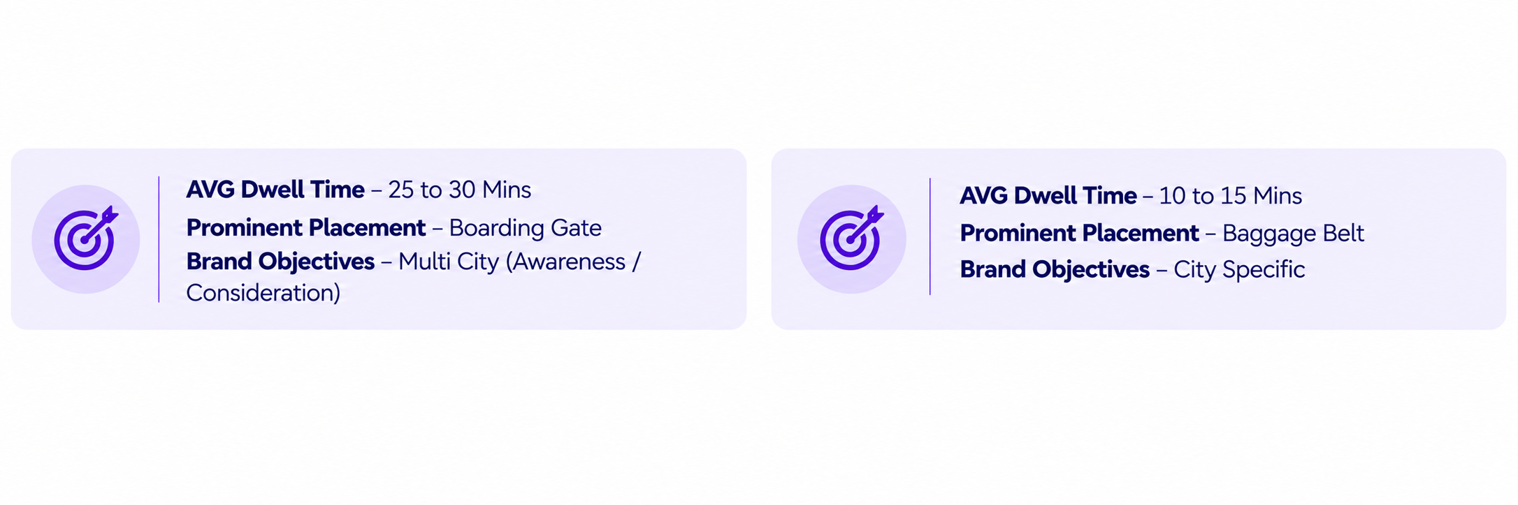
Avg. Dwell time – 5 to 10 mins
Avg. Dwell time – 5 to 10 mins
Avg. Dwell time – 10 to 15 mins
*Green Colour Denotes selection
www.themediaant.com

Slide 9

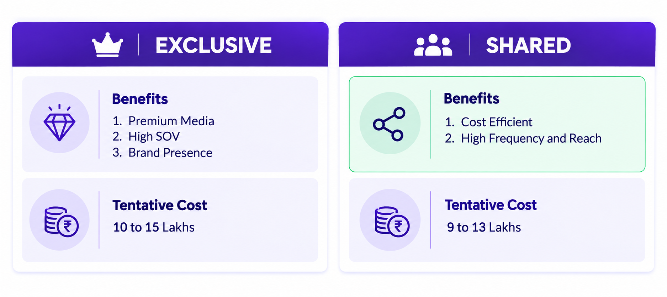
15 to 20 lakhs
10 to 15 lakhs
*Green Colour Denotes selection
www.themediaant.com

Slide 10

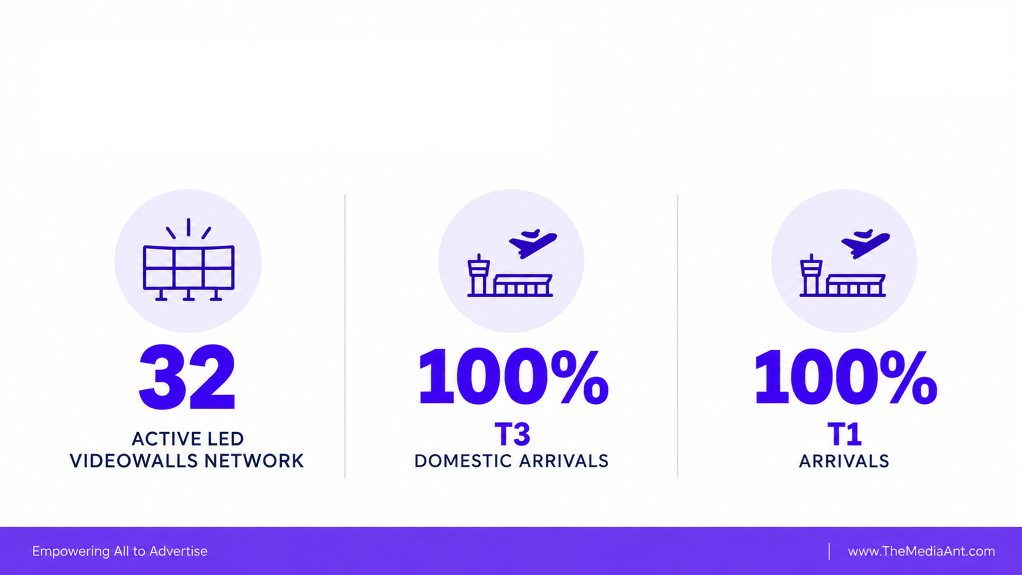
Package | Terminals Covered | Media / Screens | Price For 7 Days
Arrival Package 1 – Baggage Belt Screens | T3 Domestic + T1 | Baggage Belt Screens | ₹12,67,000
Arrival Package 2 – Digital Totems | T3 Domestic + T1 + T2 | Digital Totems @ Arrivals | ₹9,87,000
www.themediaant.com

Slide 11



Slide 12
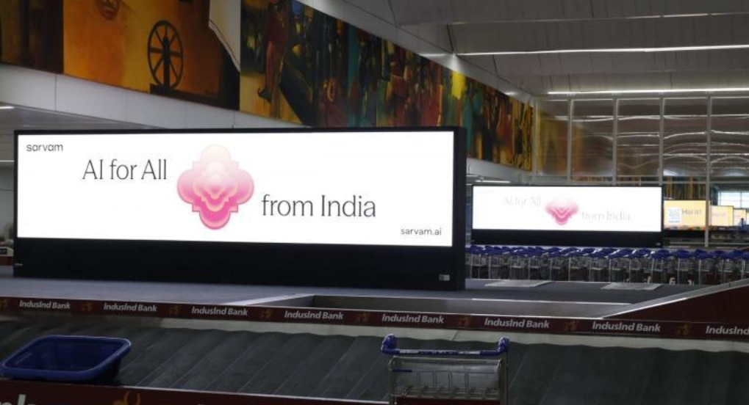
T1 & T3 Domestic Arrivals, Baggage Belt, Units – 36 (T1-16, T2-20), LED Digital Screens, Size – 16X4,
Slot – 12 Seconds, Loop – 120 Seconds
www.themediaant.com

Slide 13
COMMERCIALS SUMMARY
Airports | Package | Size of each Screen | Count of Screens by Airport | Loop Length | Package Price
T3 Domestic | Baggage Belt Screens | 16ft x 4ft | 16 | 10secs every 2 mins | 7 DAYS – 4,00,000 30 DAYS- Rs.20,00,000
T1 |  | 16ft x 4ft | 20 | 10secs every 2 mins
www.themediaant.com

Slide 14

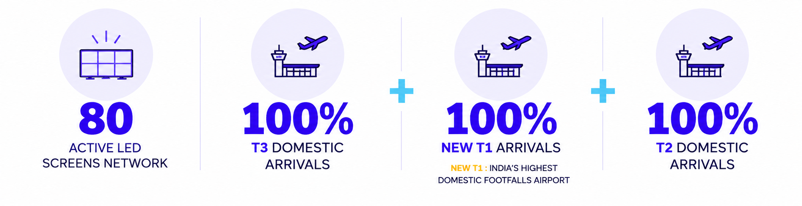

Slide 15
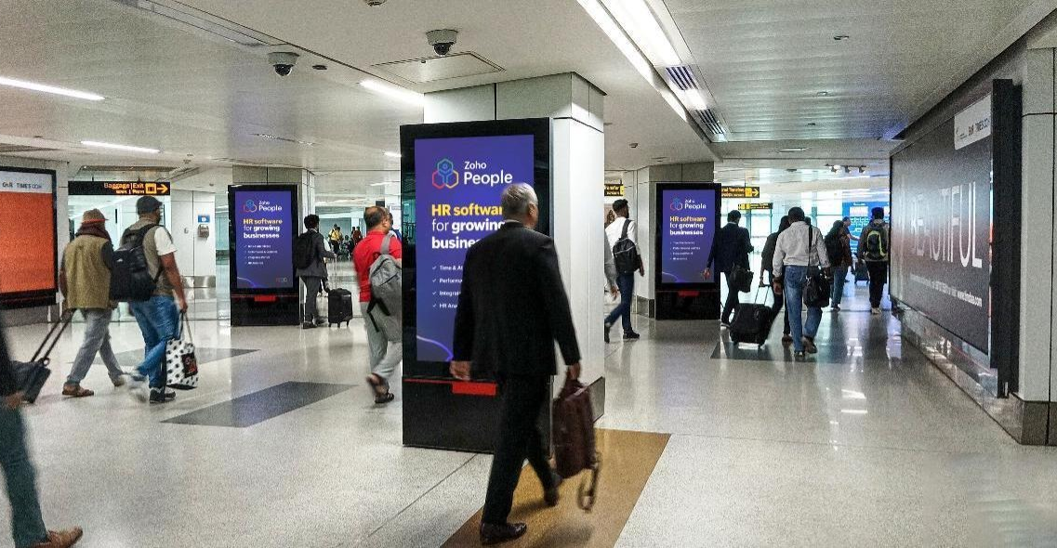
T1, T2 & T3 Domestic Arrivals, Multiple Touch Points , Units – 80, Digital Totems, Size– 65 Inches
& 75 Inches, Slot – 15 Seconds, Loop – 240 Seconds
www.themediaant.com

Slide 16
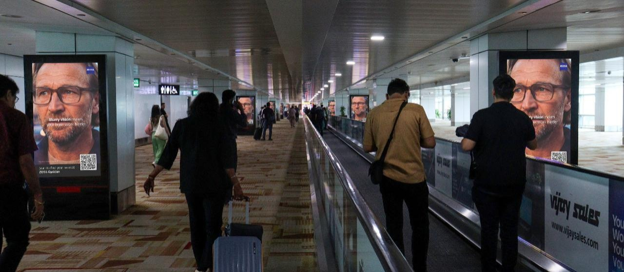
T1, T2 & T3 Domestic Arrivals, Multiple Touch Points , Units – 80, Digital Totems, Size– 65 Inches
& 75 Inches, Slot – 15 Seconds, Loop – 240 Seconds
www.themediaant.com

Slide 17
COMMERCIALS SUMMARY
Airports | Package | Size of each Screen | Count of Screens by Airport | Loop Length | Package Price
T3 Domestic | Digital Totems @ Arrivals | 65" , 4K | 50 | 15secs every 4 mins | 7 DAYS – 9.87,000 15 DAYS – 17, 00,000 30 DAYS- Rs.32,00,000
New T1 |  | 75" , 4K | 24 | 15secs every 4 mins
T2 |  | 65" 4K | 6 | 15secs every 4 mins
www.themediaant.com

Slide 18

View More

Slide 19

Notes:
35

