Slide 1



Slide 2

Clients

Slide 3


Slide 4


Slide 5


Slide 6




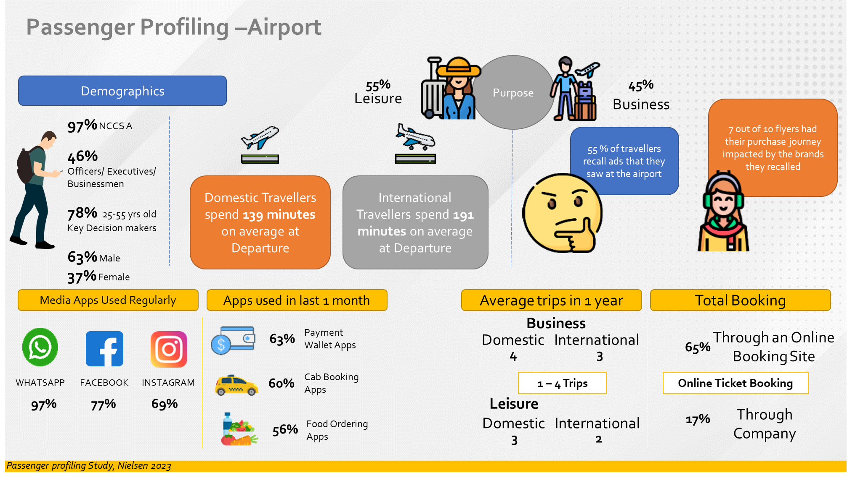




Spend Capacity
Mindset
Brand Recall
  Domestic fares filter out the bottom of the pyramid;
  International travelers skew further into HNI & SEC A+ households.
  Captive Audience with high dwell time creates high alert mindset.
  Buying Mindset – Open to discovery and considered, aspirational decisions
  A low-clutter environment drives materially higher recall, Avg of 70% SOV.
A Lifestyle Indicator, Not Just a Ticket – highly receptive and possesses high spend capacity
www.themediaant.com

Slide 7
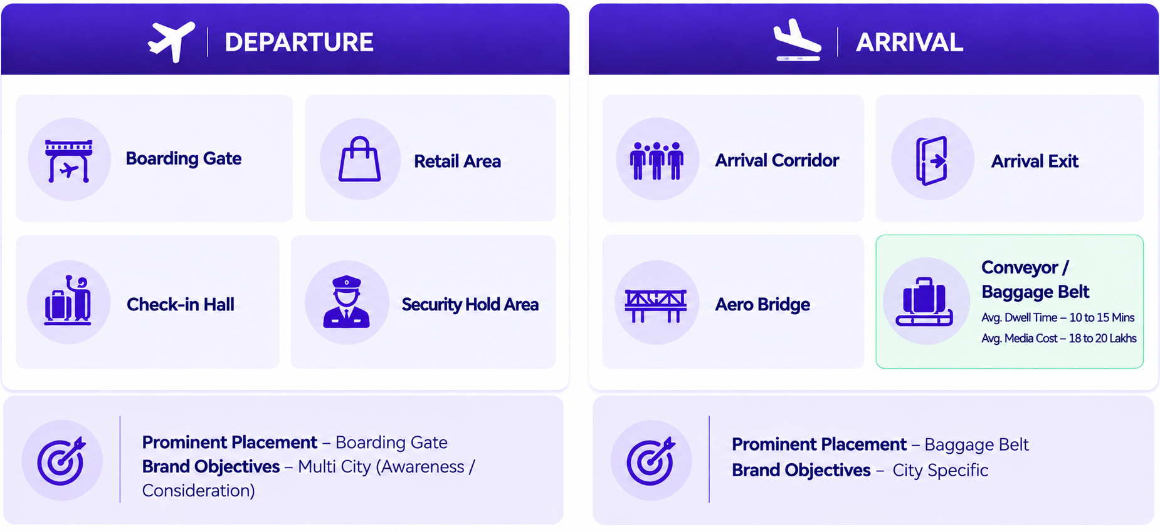
MEDIA SELECTION CRITERIA
BY LOCATION
Avg. Dwell time – 5 to 10 Mins
Avg. Media Cost – 15 to 20 Lakhs
cv
*Green Colour Denotes selection
www.themediaant.com

Slide 8
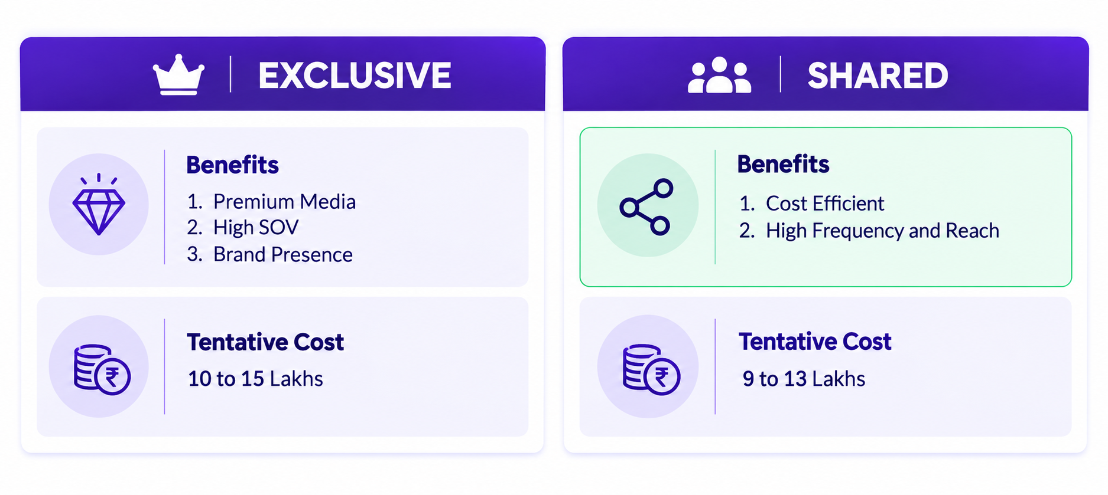
MEDIA SELECTION CRITERIA
BY TYPE
15 to 20 lakhs
10 to 15 lakhs
*Green Colour Denotes selection
www.themediaant.com

Slide 9
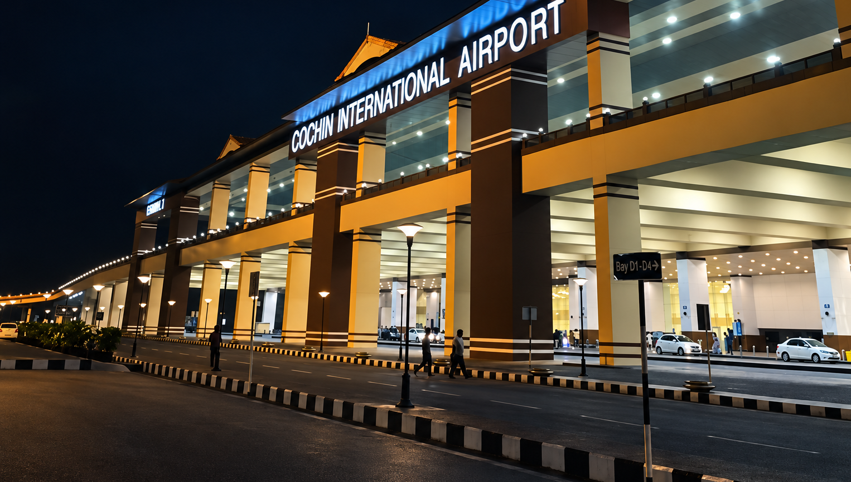
COCHIN AIRPORT

Slide 10
PACKAGE SUMMARY
No | Location | Unit | Media Type | Loop | Display Cost For 1 Month | Display Cost For 7 Days | Uploading / Production Charges | Package Cost For 7 days
1 | Domestic Baggage Belt | 1 | Static Light Box | - | 12L | 2.8L | 9600 | Rs. 6.8L
2 | Baggage Hall & Arrival Exit | 30 | Digital Totems | 10secs every 2 mins | 18L | 4.2L | 0
3 | International + Domestic Baggage Belt | 9 | Digital Screen | 10secs every 2 mins | 19L | 4.4L | 0 | Rs. 4.4L
www.themediaant.com

Slide 11

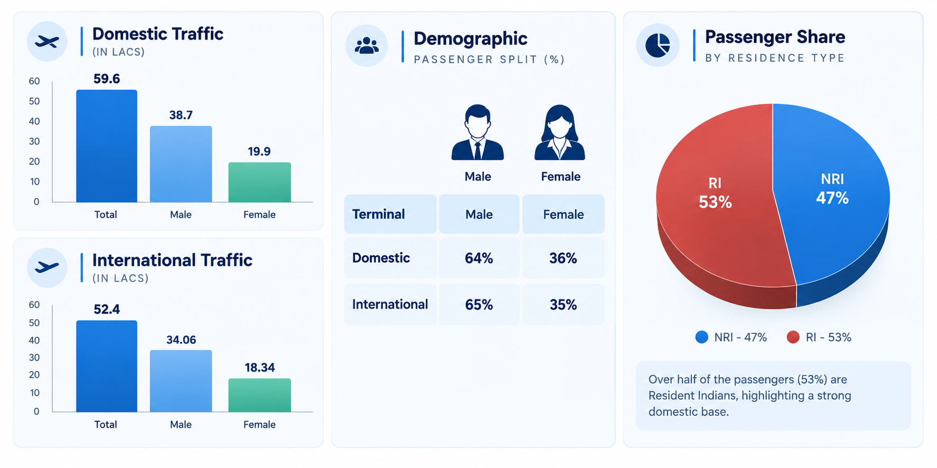
CONSUMER PROFILE AT DELHI AIRPORT
www.themediaant.com

Slide 12
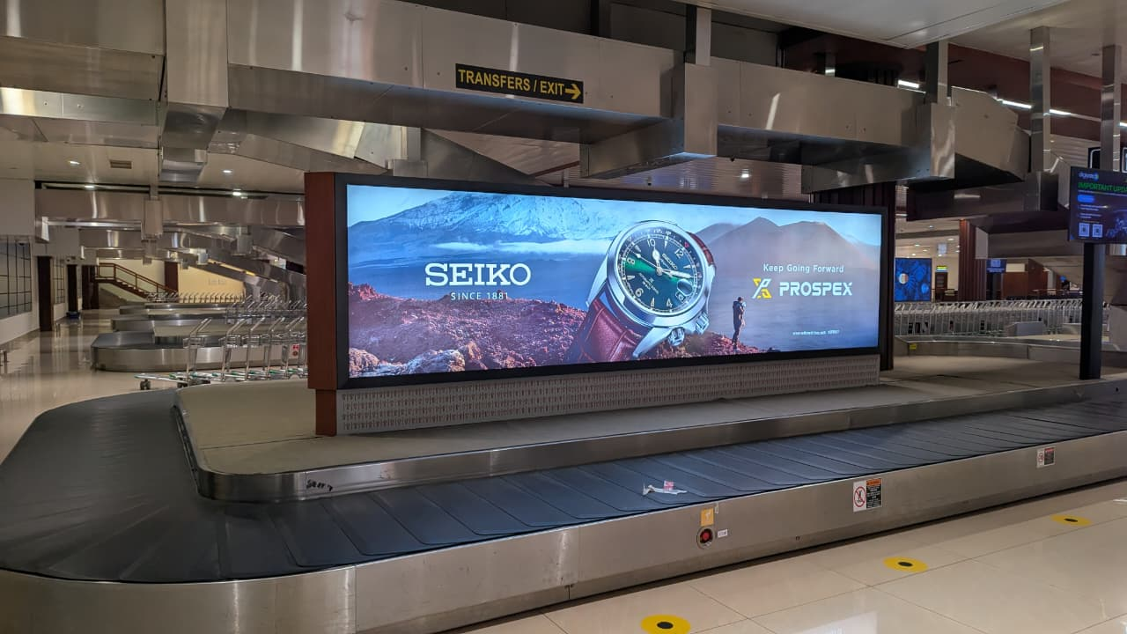
Cost Per Month 12,00,000 + 9,600 Production + GST
Cost for 7 Days 2,80,000 + 9,600 Production + GST
Recommended Media Option
Rationale :
Catering to 70 % of the Arrival traffic
Exclusive media
head-on site at the entry point of the
baggage claim area (High Dwell time)
Domestic Arrivals, Baggage Belt Display, Unit- 1, Size – 5X7, Exclusive Static Lightbox
www.themediaant.com

Slide 13


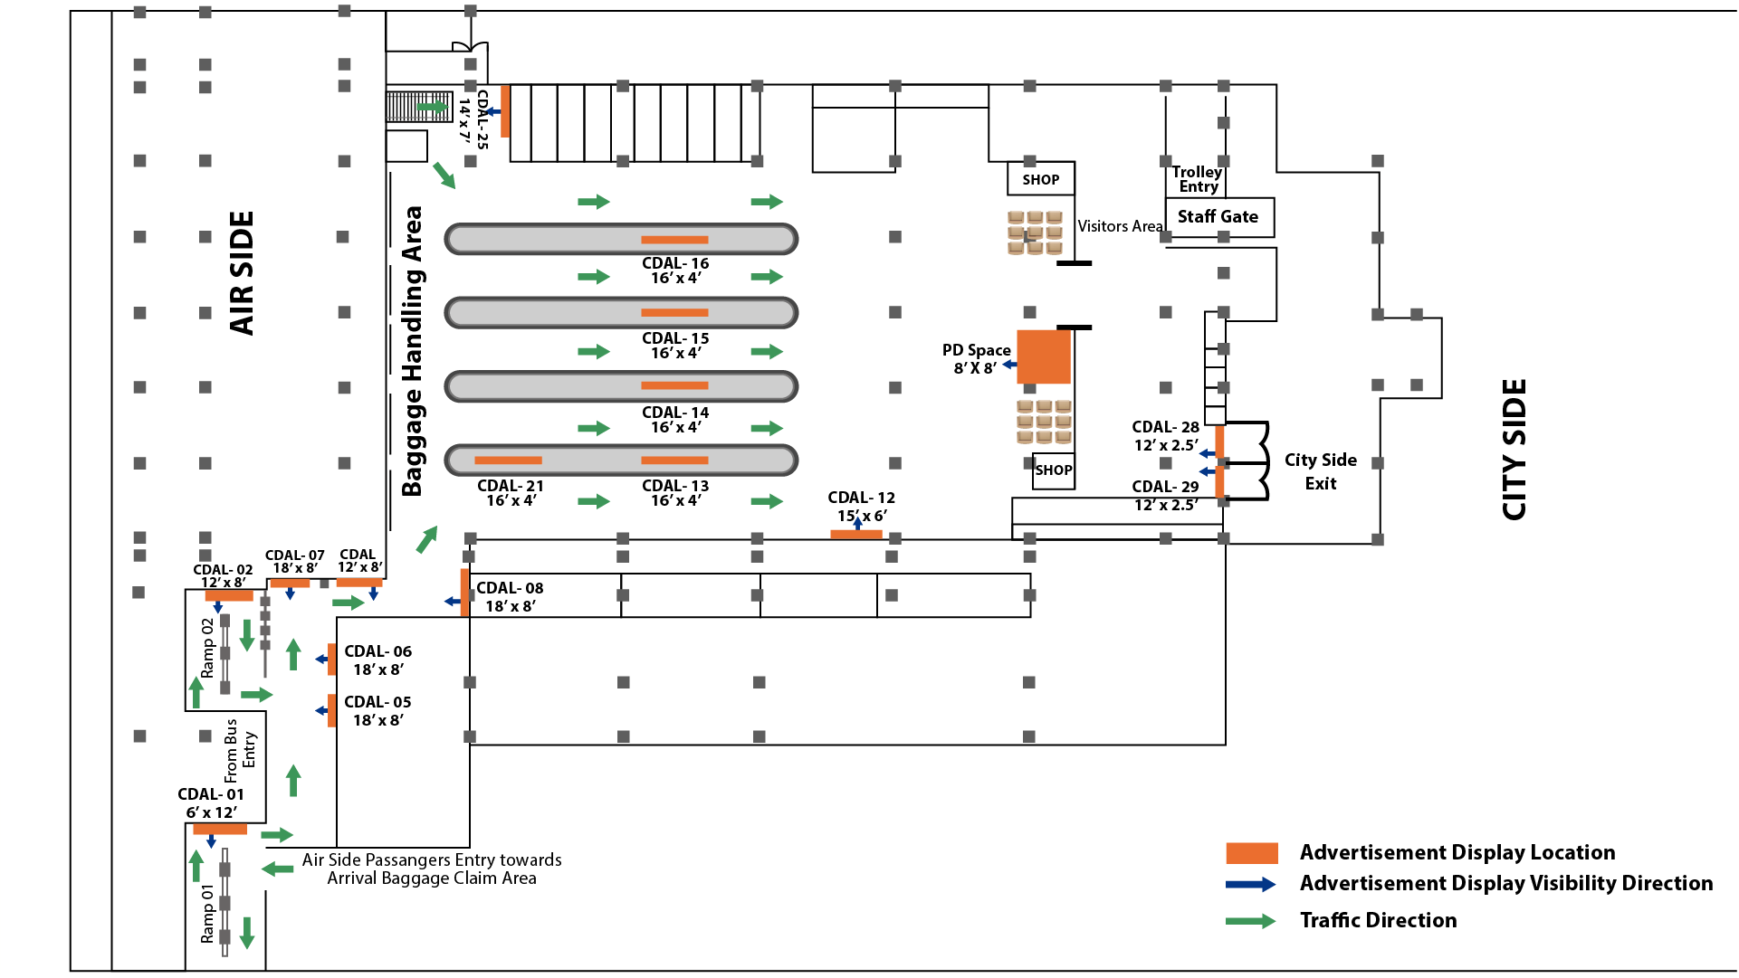
Towards Pier Junction
www.themediaant.com

Slide 14
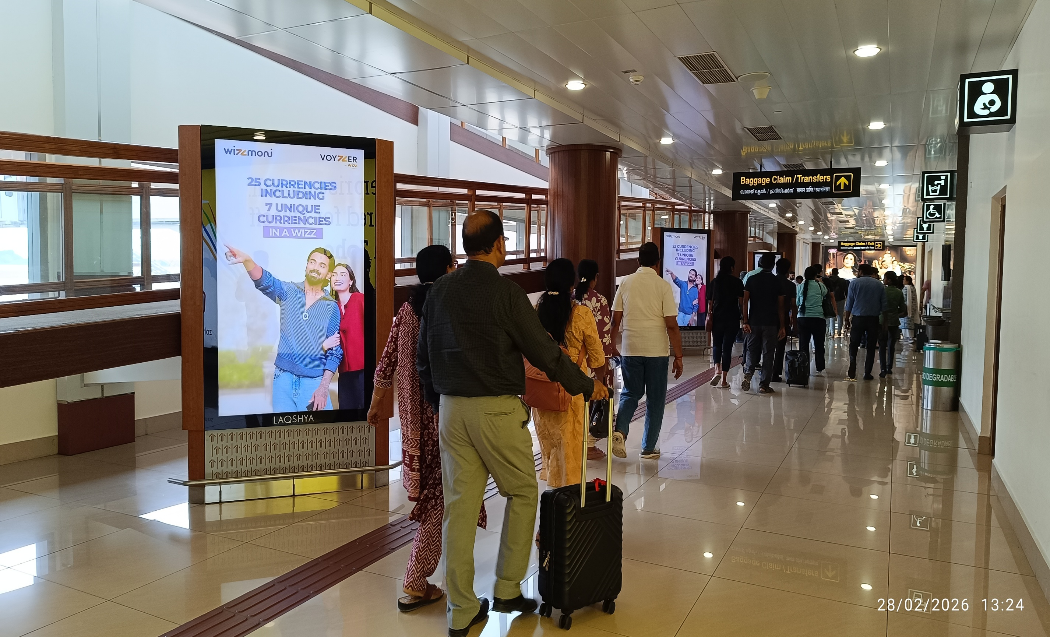
Cost Per Month 18,00,000 + GST
Cost For 7 Days 4,20,000 + GST
International + Domestic Arrivals, Baggage Hall & Arrival Exit , Unit – 30 Size – 16X4, Digital Totems, Loop – 10 Seconds every 2 mins
www.themediaant.com

Slide 15

COMMERCIALS SUMMARY
Cochin Airport | Package | Size of each Screen | Count of Screens by Airport | Loop Length | Package Price
International Arrivals | Digital Totems | 75 inches | 14 Units | 10secs every 2 mins | 7 DAYS – 4,20,000 30 DAYS- Rs.18,00,000
Domestic Arrivals |  | 75 inches | 16 Units | 10secs every 2 mins
www.themediaant.com

Slide 16
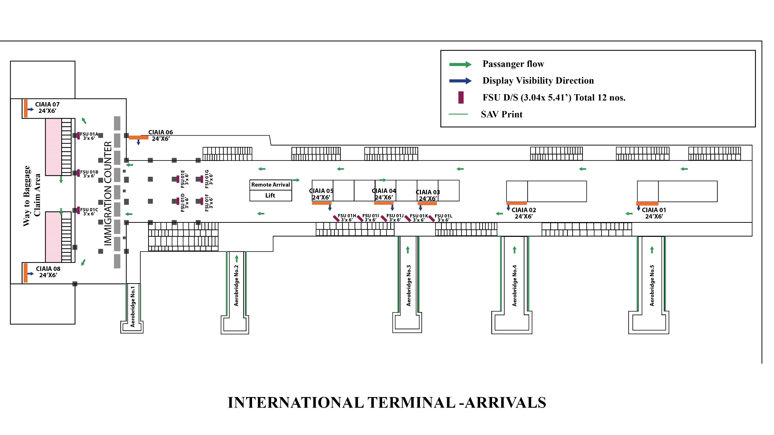
Towards Pier Junction
www.themediaant.com

Slide 17
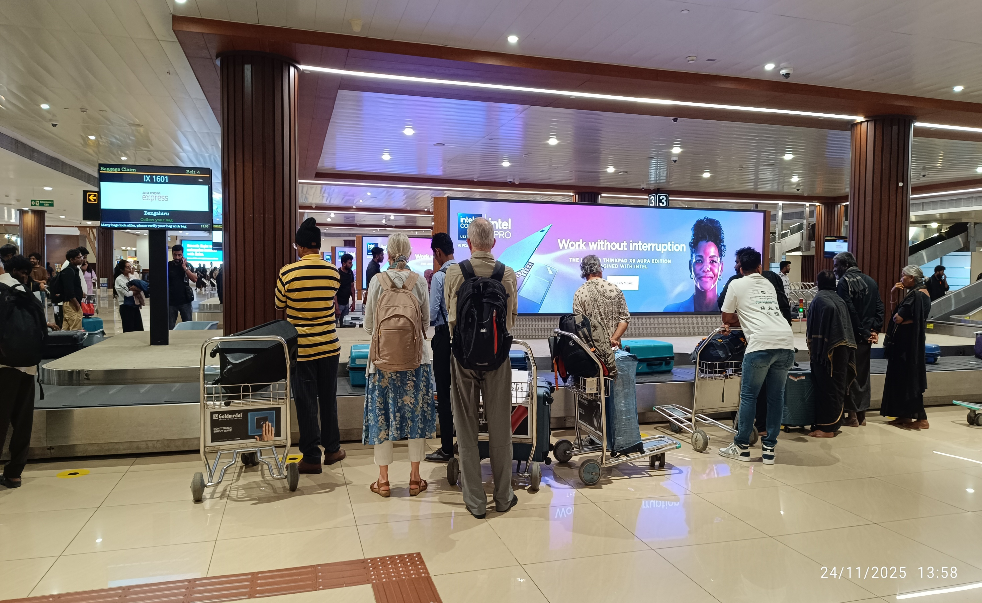
Cost Per Month Rs. 19,00,000 + GST
Cost For 7 Days Rs. 4,40,000 + GST
International + Domestic Arrivals, Baggage Belt Screens, Unit – 9 Screens - 18 Size – 16X4 (Double sided), Digital Screen, Loop – 10 Seconds every 2 mins
www.themediaant.com

Slide 18

COMMERCIALS SUMMARY
Cochin Airport | Package | Size of each Screen | Count of Screens by Airport | Loop Length | Package Price
International Arrivals | Baggage Belt Screens | 16ft x 4ft 2 Sides | 5 Units, 10 Screens | 10secs every 2 mins | 7 DAYS – 4,40,000 30 DAYS- Rs.19,00,000
Domestic Arrivals |  | 16ft x 4ft 2 Sides | 4 Units. 8 Screens | 10secs every 2 mins
www.themediaant.com

Slide 19
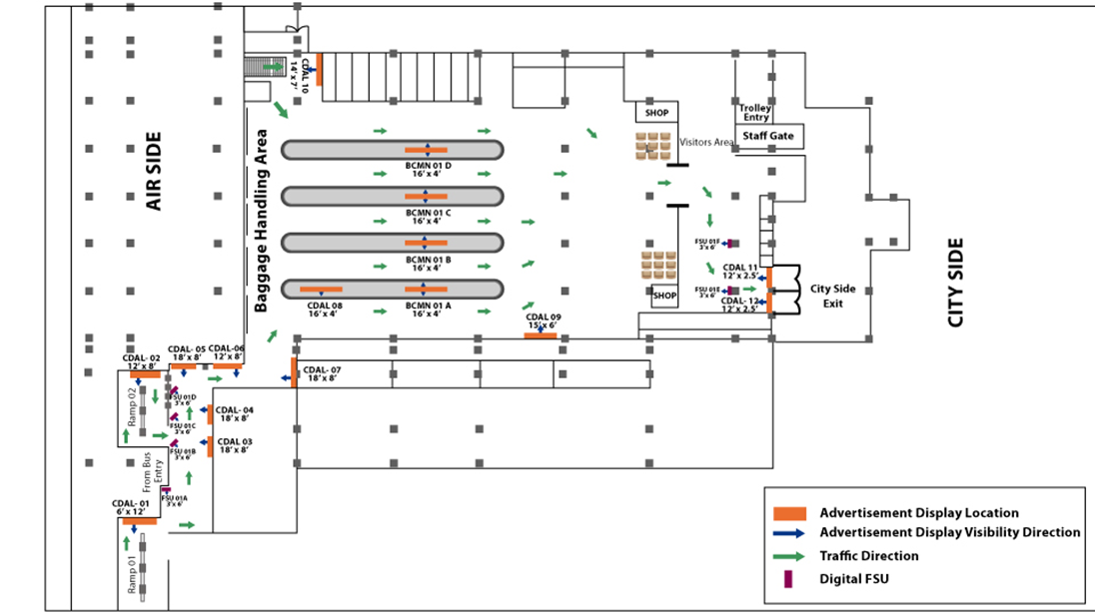
Towards Pier Junction
www.themediaant.com

Slide 20
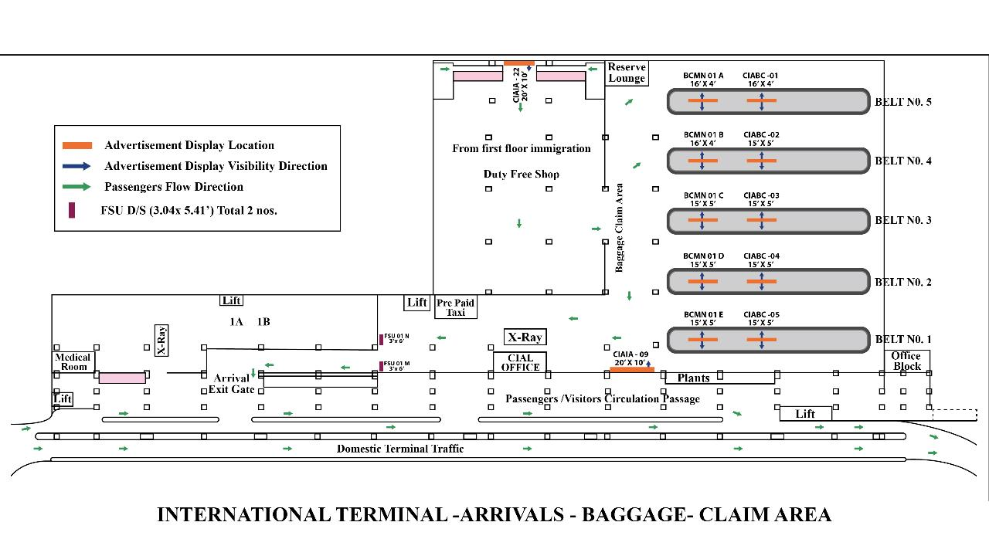
Towards Pier Junction
www.themediaant.com

Slide 21

View More

Slide 22

Notes:
35

